Slide 1
PREDICTING OPTIMAL ORDER QUANTITY TO IMPROVE RETURN RATE ON CRITICAL PRODUCTS

Slide 2
01
INTRODUCTION
General description of the project

Slide 3
DEMAND FORECASTING
Perfecting order sales based on demand forecasting on food with short shelf-life is one of the main concerns on preventing losses and food waste (Tsoumakas, 2019).
BALANCE
Find a balance between predicted sales and an expected return rate based on the freshness of the product and the expiration date.
ML TIME-SERIES PREDICTION
Use machine learning algorithms that uses sales and orders prediction including the challenges and opportunities that a model like this would bring for replicability in similar industries.

Slide 4
02
PURPOSE
What we want to achieve

Slide 5
RESEARCH QUESTION
How can we predict the optimal order based on sales and return rate?
PURPOSE
Find a model that helps predict the optimal order for a major bread company using sales trends in balance with the return rate of the product. This prediction would consider the replicability of the process on different products and routes and the possibility using various statistical tools like ARIMA, Linear Regression, Prophet, LSTM, Simple Moving Average, and XGBoost Regressor.

Slide 6
RESEARCH HYPOTHESIS
Null hypothesis: The correlation between sales and returns rate used to predict an optimal order is not statistically significant.
Alternate hypothesis: The correlation between sales and returns rate used to predict an optimal order is statistically significant.

Slide 7
03
METHODOLOGY
How the project was structured

Slide 8
DATA
CLEANING
MODEL
TESTING
1
2
3
4
5
DATA
COLLECTION
DATA
PROCESSING
COMPARE
RESULTS

Slide 9
04
DATA PROCESSING
Statistic summary and data cleaning

Slide 10
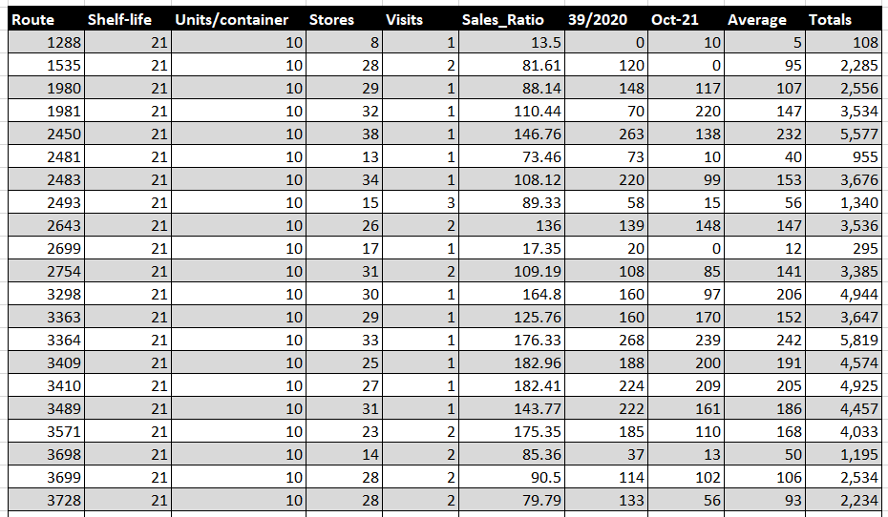
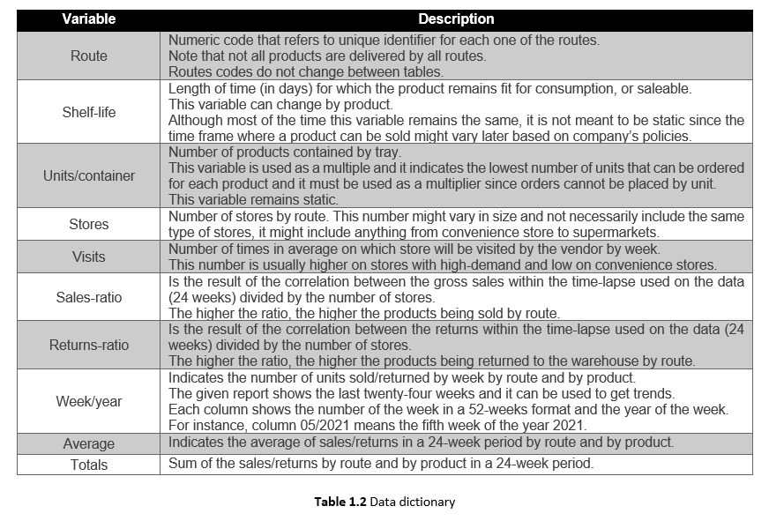
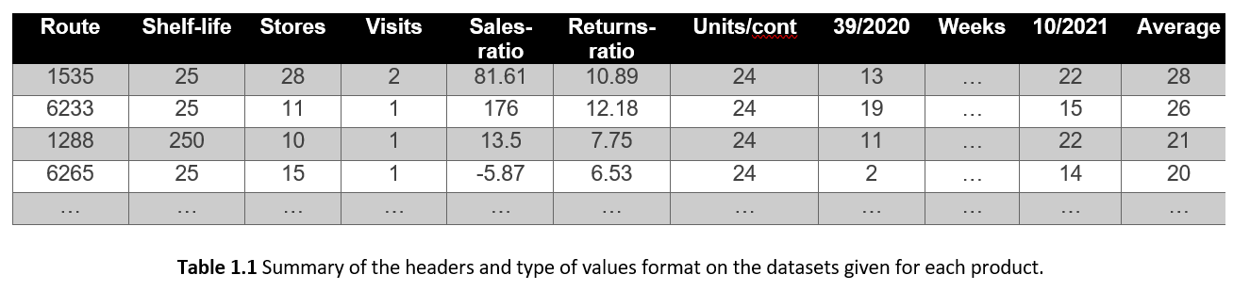
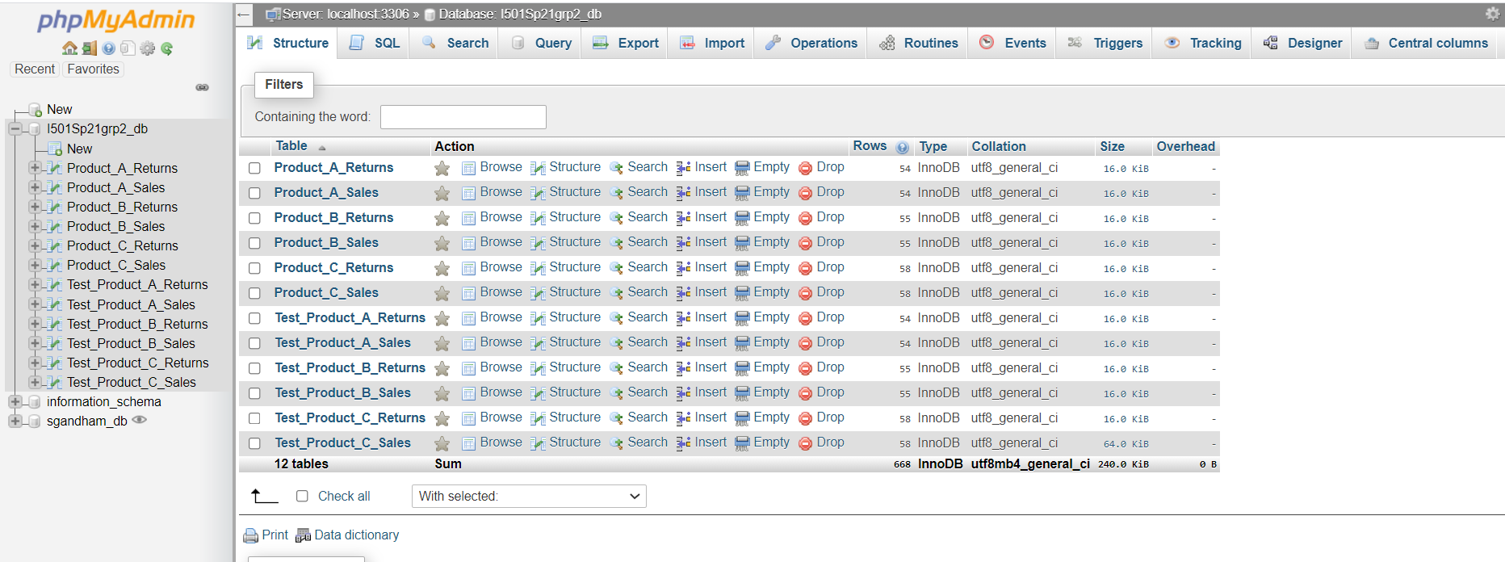
ABOUT THE DATASET

Slide 11
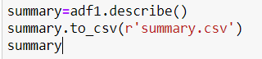
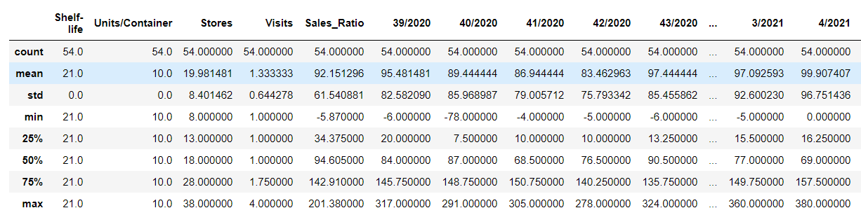
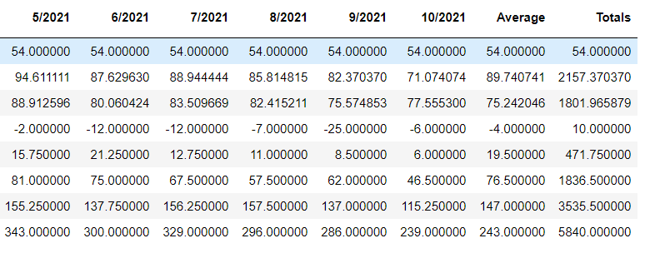
DESCRIPTIVE STATISTICS

Slide 12
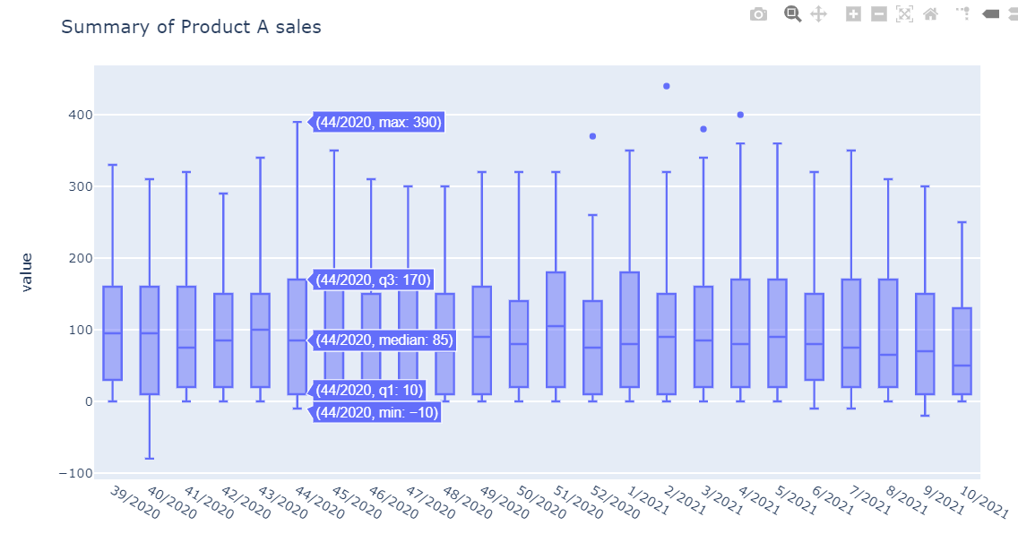
DESCRIPTIVE STATISTICS

Slide 13
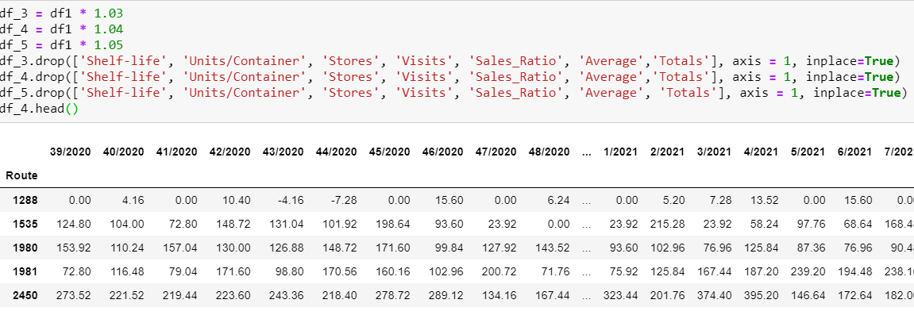
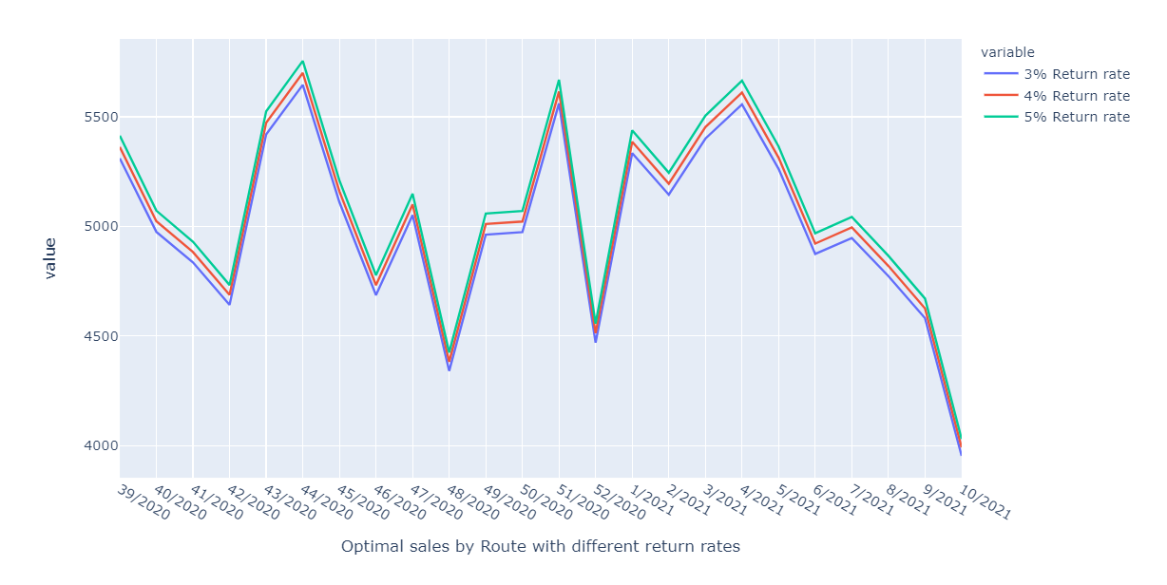
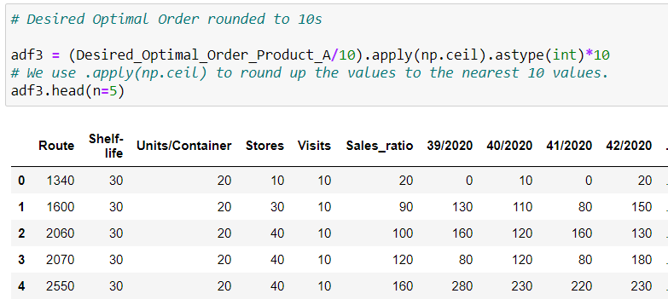
FINDING THE OPTIMAL ORDER

Slide 14
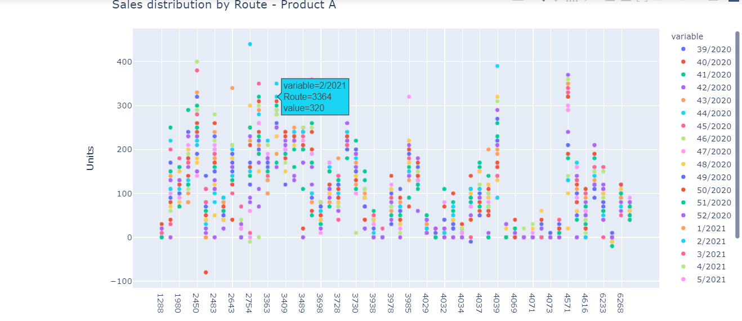
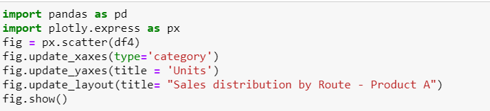
VISUALIZING THE DATA

Slide 15
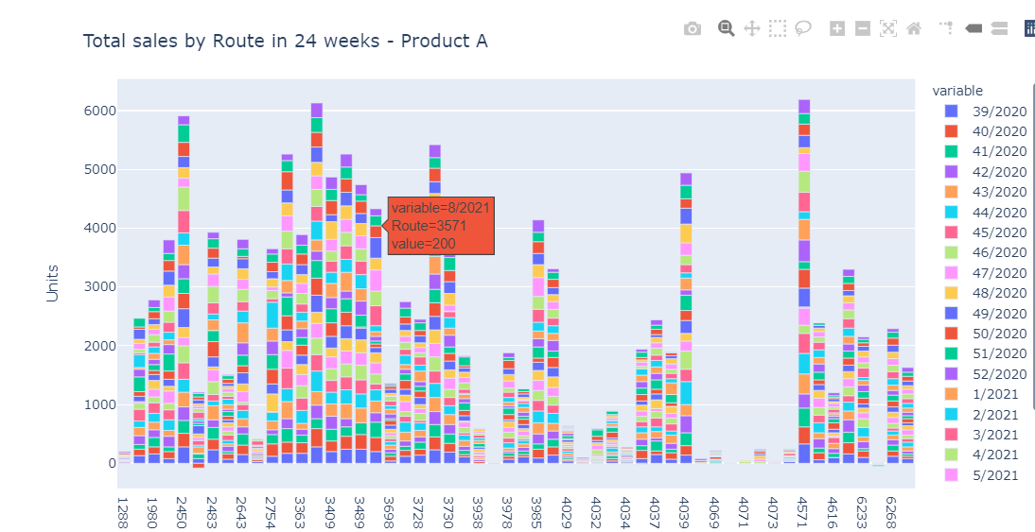
VISUALIZING THE DATA

Slide 16
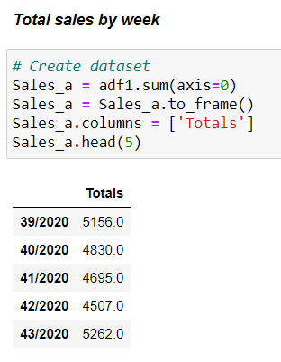
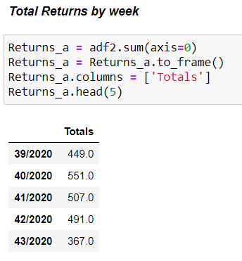
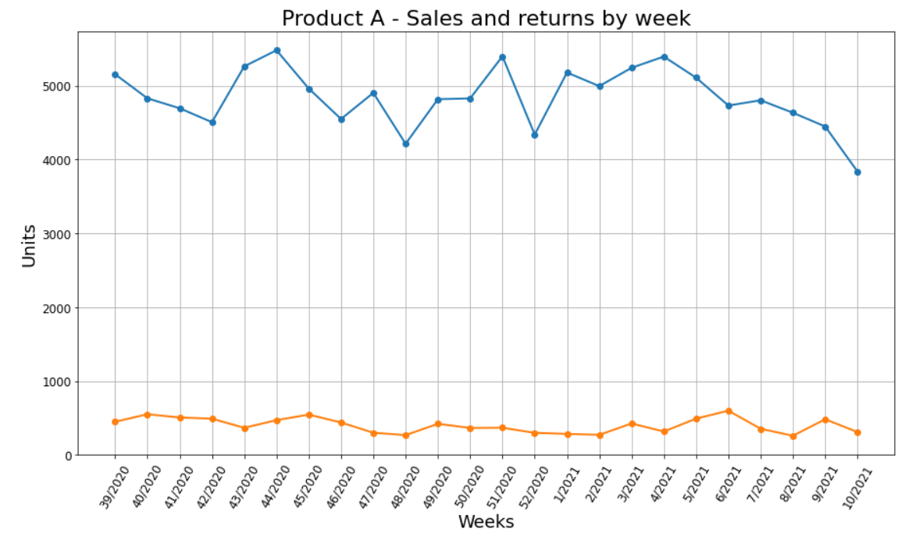
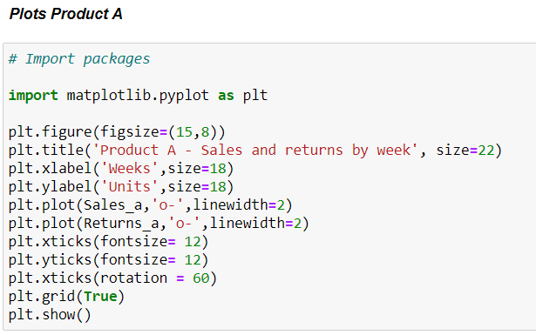
VISUALIZING THE DATA

Slide 17
05
PREDICTING MODELS
Time-series prediction

Slide 18
MODELS TESTED
TIMES-SERIES PREDICTION
1
Linear Regression
2
Autoregressive Integrated Moving Average Model (ARIMA)
3
Simple Moving Average
4
XGBoost Regressor
5
Prophet
6
Long Short-term Memory LSTM

Slide 19
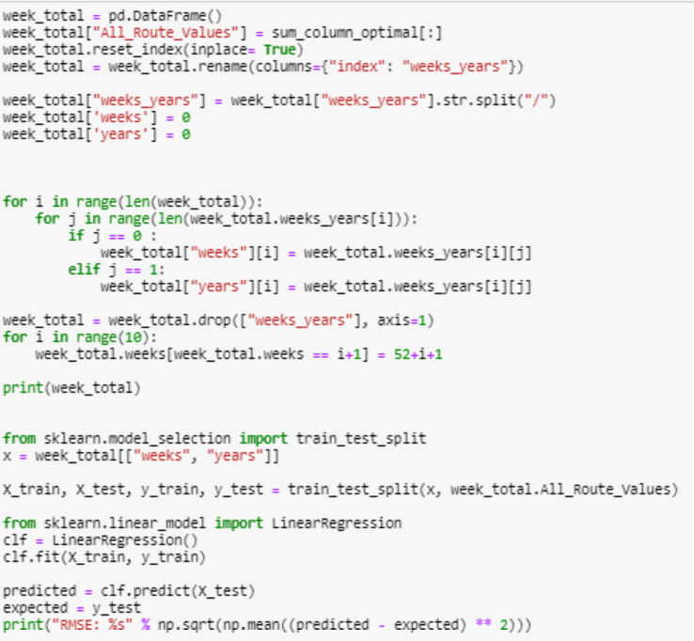
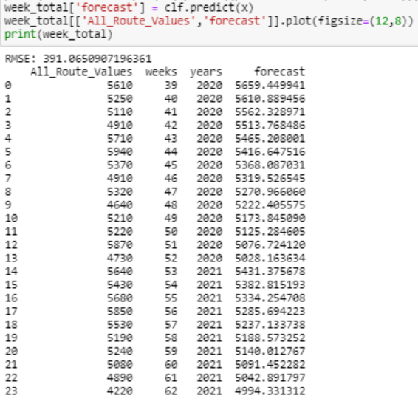
LINEAR REGRESSION

Slide 20
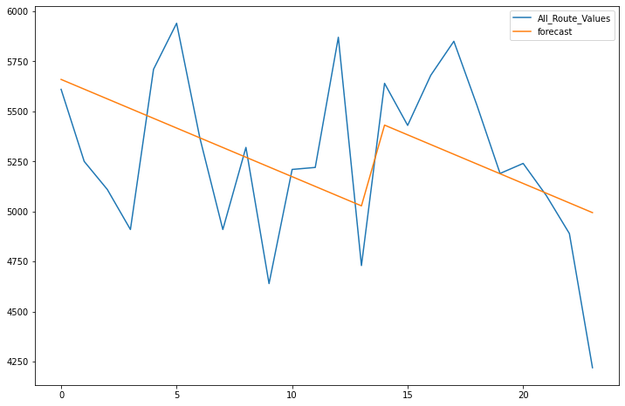
LINEAR REGRESSION

Slide 21
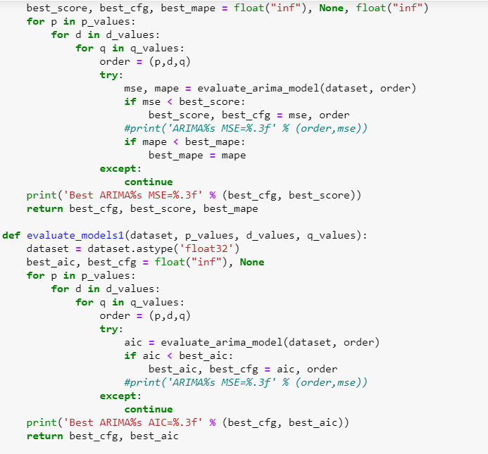
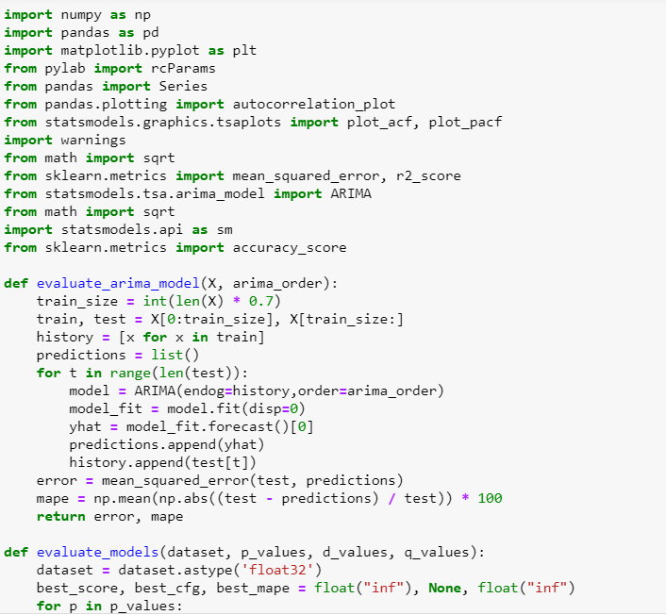
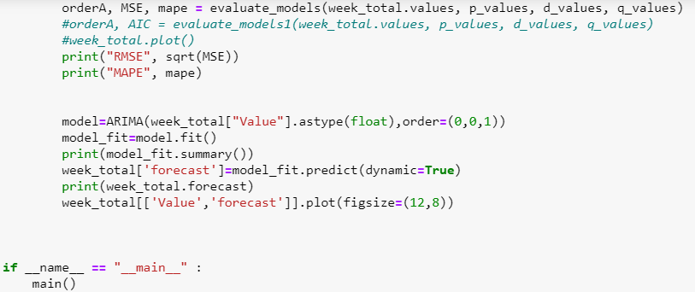
ARIMA (Autoregressive Integrated Moving Average Model)

Slide 22
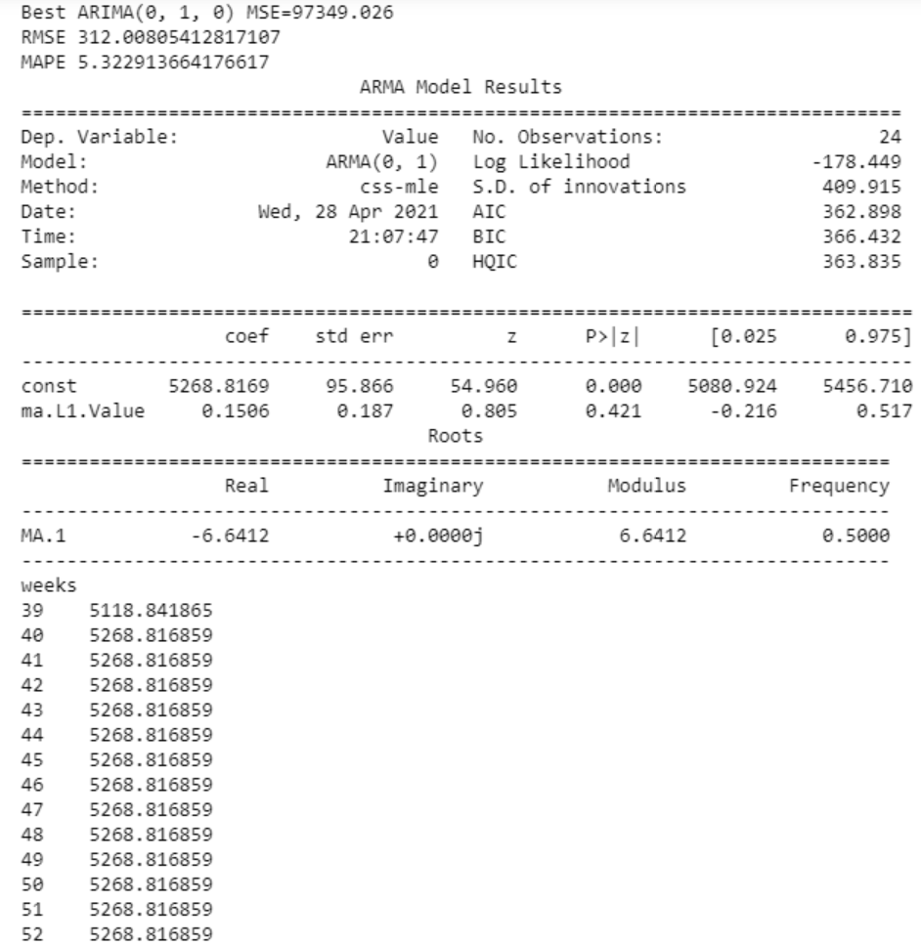
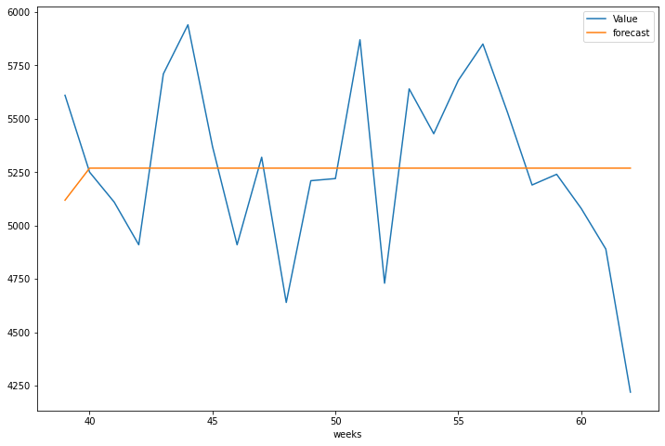
ARIMA (Autoregressive Integrated Moving Average Model)

Slide 23
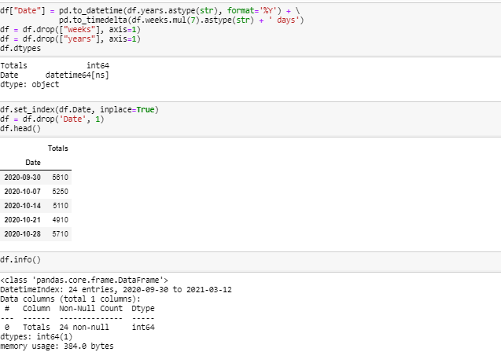
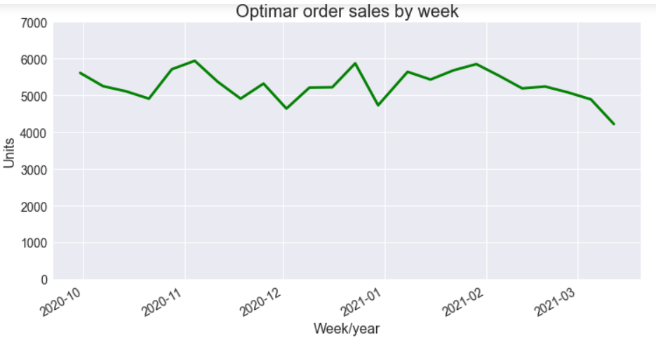
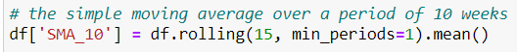
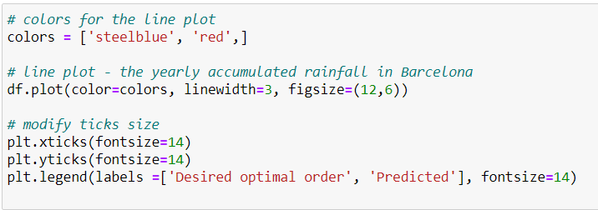
SIMPLE MOVING AVERAGE

Slide 24
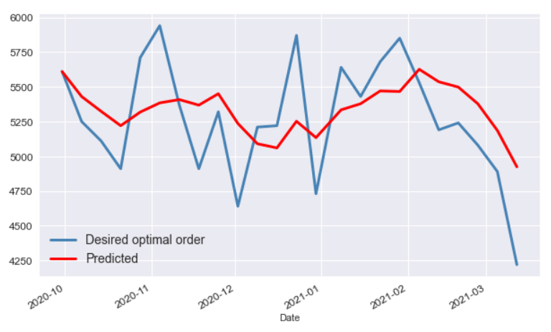
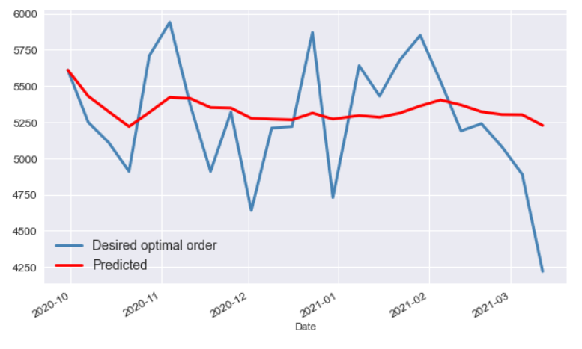
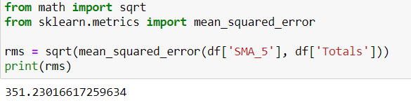
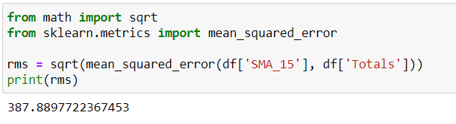
SIMPLE MOVING AVERAGE

Slide 25
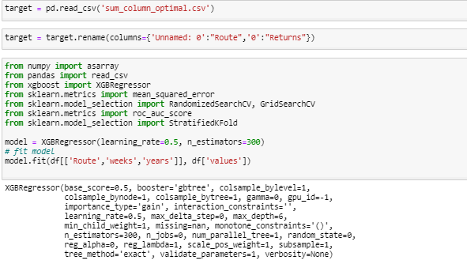
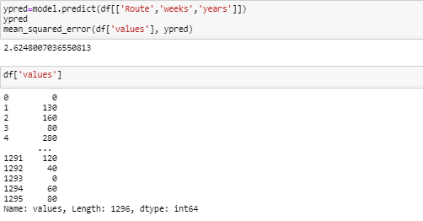
XGBOOST REGRESSOR

Slide 26
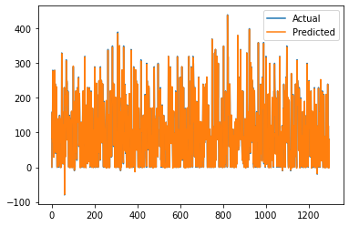
XGBOOST REGRESSOR

Slide 27
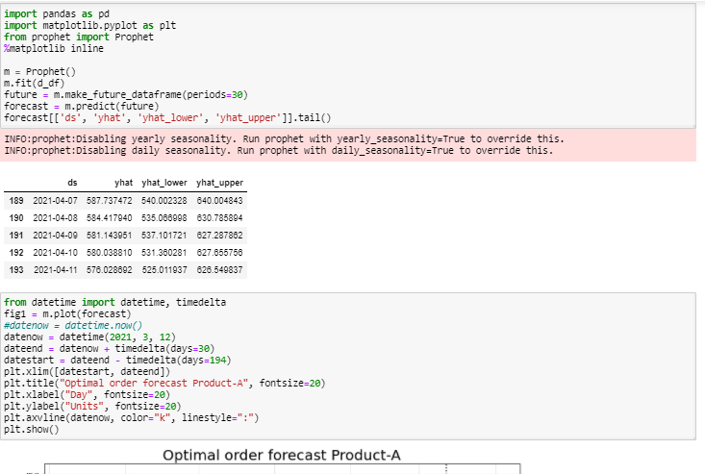
PROPHET

Slide 28
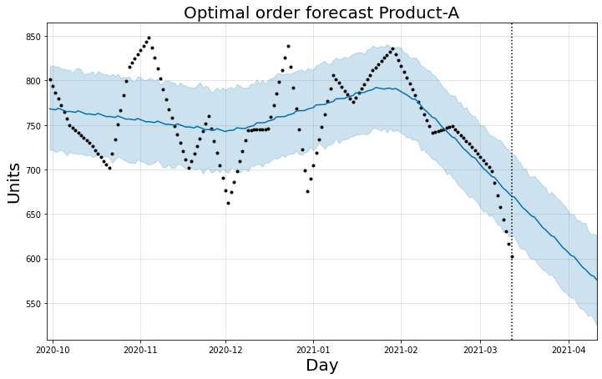
PROPHET

Slide 29
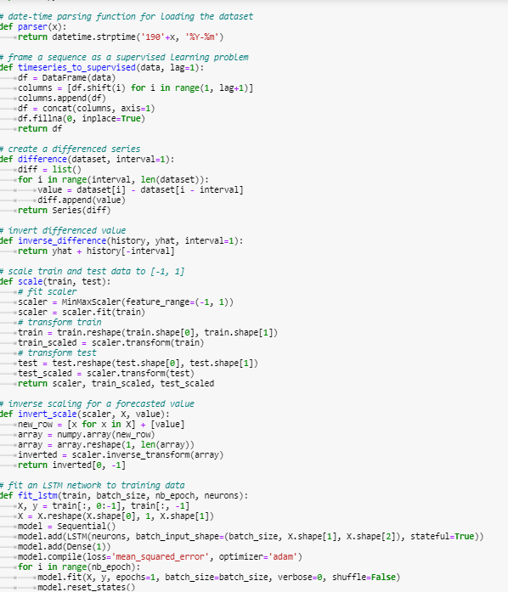
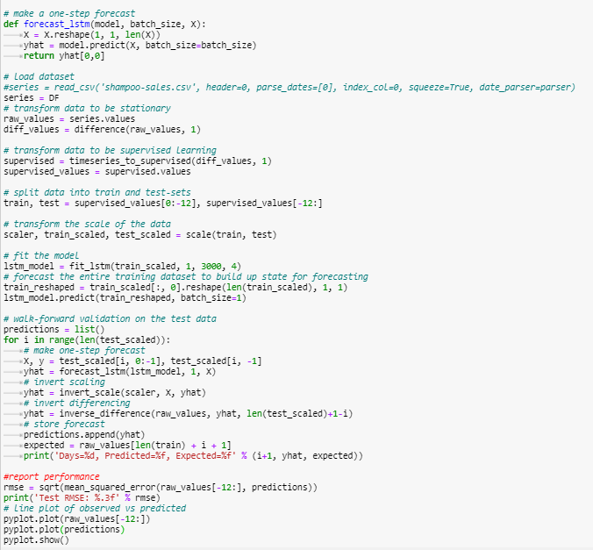
LSTM (Long Short-Term Memory) First Approach

Slide 30
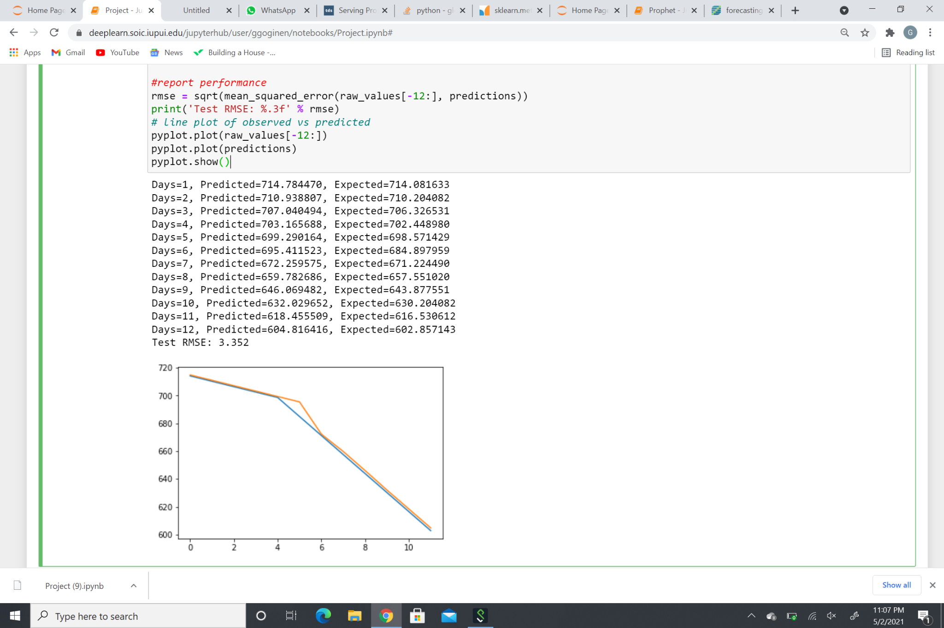
LSTM (Long Short-Term Memory) First Approach

Slide 31
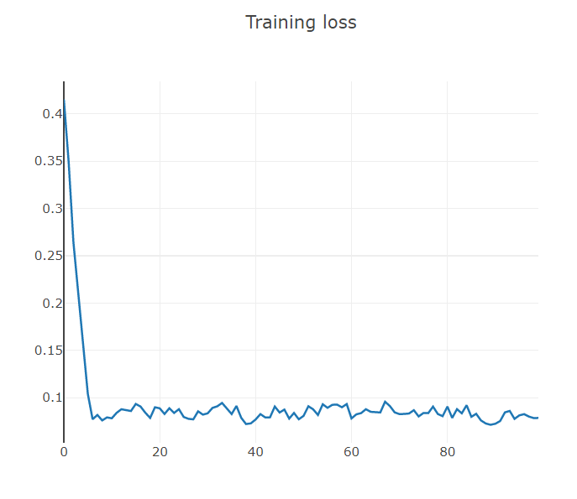
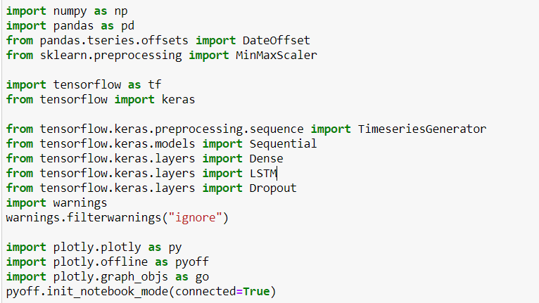
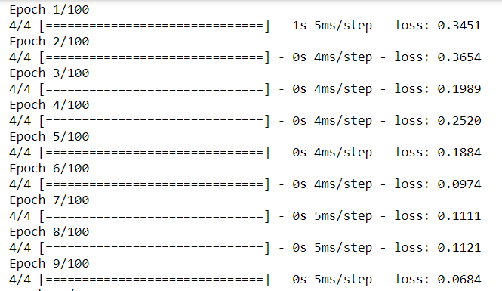
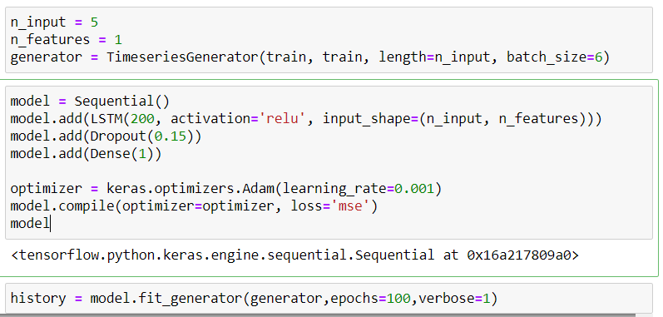
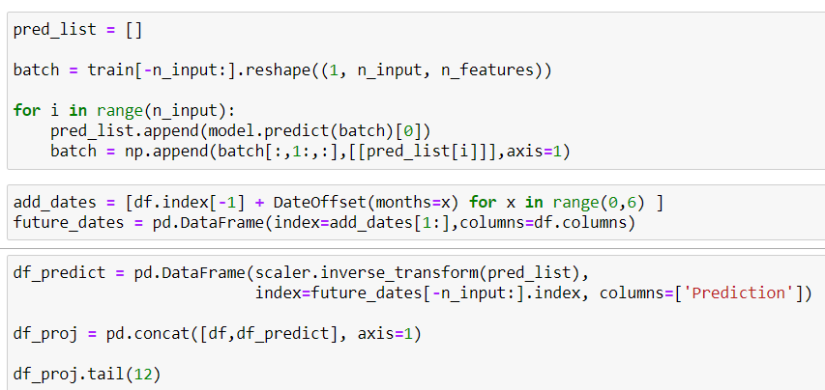
LSTM (Long Short-Term Memory) Second approach

Slide 32
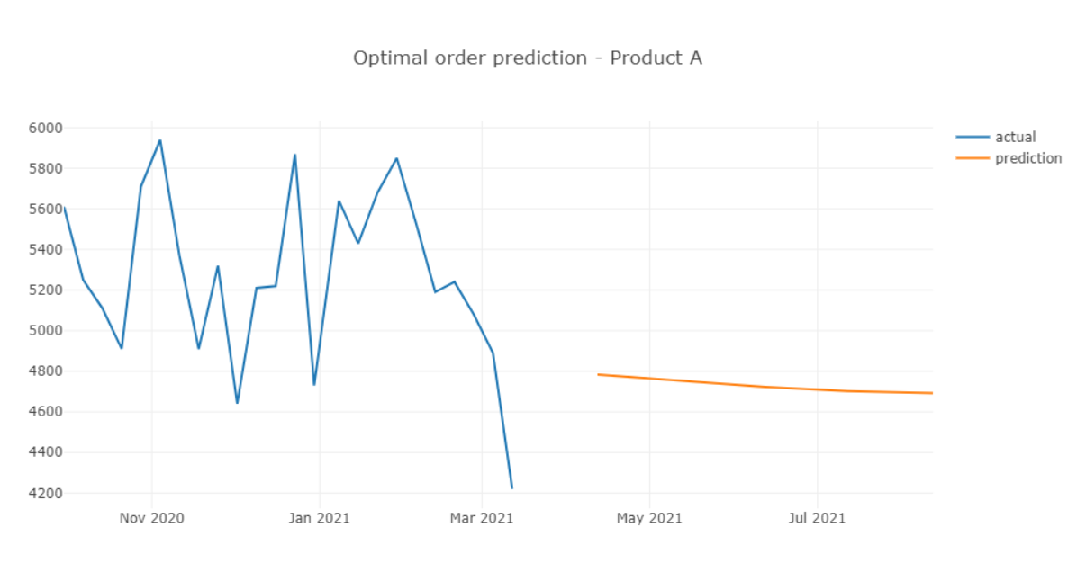
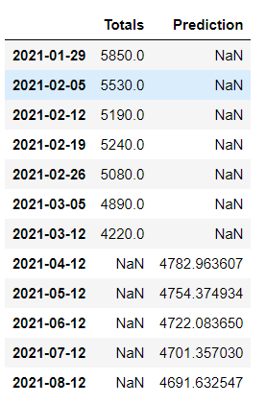
LSTM (Long Short-Term Memory) Second approach

Slide 33
06
RESULTS
General findings

Slide 34
LINEAR
REGRESSION
ARIMA
MODEL
SIMPLE MOVING
AVERAGE
RMSE: 391.065
SIMPLIFIED
RMSE: 312.008
OVER-SIMPLIFIED
RMSE: 351.230
SIMPLIFIED
XGBOOST REGRESSOR
LONG SHORT TERM MEMORY
PROPHET
RMSE: 1.141
OVERFITTING
RMSE: 41.408
BETTER FIT
RMSE: 3.352
GOOD FIT

Slide 35
HYPOTHESIS
We reject the null hypothesis as we were able to predict future orders with an statistically significant approach.

Slide 36
07
REFERENCES
Academic bibliography

Slide 37
REFERENCES
Bajari, P., Nekipelov, D., Ryan, S. P., & Yang, M. (2015). Machine Learning Methods for Demand Estimation. American Economic Review, 105(5), 481-485. https://www.aeaweb.org/articles?id=10.1257/aer.p20151021
H. Sang and S. Takakuwa, "A simulation-based approach for obtaining optimal order quantities of short-expiration date items at a retail store," Proceedings of the 2012 Winter Simulation Conference (WSC), Berlin, Germany, 2012, pp. 1-12, doi: 10.1109/WSC.2012.6465063. https://waseda.pure.elsevier.com/en/publications/a-simulation-based-approach-for-obtaining-optimal-order-quantitie
Krishna, A., V, A., Aich, A., & Hegde, C. (2018). Sales-forecasting of Retail Stores using Machine Learning Techniques. 2018 3rd International Conference on Computational Systems and Information Technology for Sustainable Solutions (CSITSS). doi:10.1109/csitss.2018.8768765 https://ieeexplor e.ieee.org/document/8768765
Tsoumakas, G. (2019). A survey of machine learning techniques for food sales prediction. Artificial Intelligence Review, 52(1), 441-447. https://dl.acm.org/doi/abs/10.1007/s10462-018-9637-z

Slide 38
REFERENCES
Y. Kaneko and K. Yada, "A Deep Learning Approach for the Prediction of Retail Store Sales," 2016 IEEE 16th International Conference on Data Mining Workshops (ICDMW), Barcelona, Spain, 2016, pp. 531-537, doi: 10.1109/ICDMW.2016.0082. https://ieeexplore.ieee.org/document/7836713
Patric. M, Mykola.P, (January 2008), Food Sales Prediction: “If Only It Knew What We Know”. IEEE International Conference on Data Mining Workshops. https://www.win.tue.nl/~mpechen/publications/pubs/MeulsteeDDDM08.pdf.
Robert.S, Christopher.D. (June 12, 2017), Predicting sales in a food store department using machine learning. KTH, School of Computer Science and Communication. http://www.diva-portal.org/smash/get/diva2:1108597/FULLTEXT01.pdf

Slide 39
Gowtham Gogineni
THANK YOU

